Slide 1
Machine Learning Types
Dr.K DeviPriya
CSE(AI&ML)

Slide 2
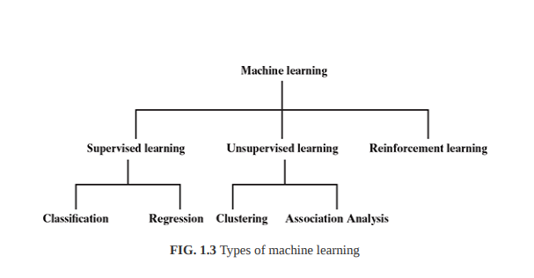
Types of Machine Learning

Slide 3
1. Supervised learning – Also called predictive learning. A machine predicts the class of unknown objects based on prior class-related information of similar objects.
2. Unsupervised learning – Also called descriptive learning. A machine finds patterns in unknown objects by grouping similar objects together.

Slide 4
3. Reinforcement learning – A machine learns to act on its own to achieve the given goals.

Slide 5
Supervised Learning
Supervised learning is the types of machine learning in which machines are trained using well "labelled" training data, and on basis of that data, machines predict the output. The labelled data means some input data is already tagged with the correct output.

Slide 6
Supervised Learning understanding the relationship between given SET OF FEATURES, a target value also known as LABEL/CLASS

Slide 7
Concept for Marks prediction, and Loan Paid
SNO | Attendance | Certification | Marks(Target)
1 | 60 | 5 | 80
2 | 70 | 3 | 87
3 | 65 | 4 | 76
4 | 30 | 0 | 20
Age | Gender | EducationLevel | Income | Marital | Previous Loan Paid(Target)
40 | F | U | 50K | Y | Yes
20 | F | SSC | 10K | N | No
34 | M | UG | 35 | Y | Yes
45 | M | Pg | 80K | Y | yes

Slide 8
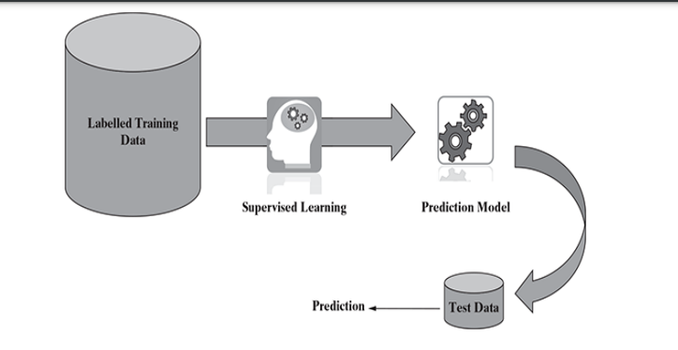
Supervised Learning

Slide 9
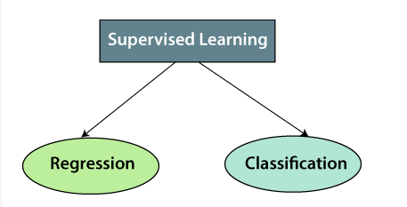
Types of Supervised Learning

Slide 10
1. Regression
Regression algorithms are used if there is a relationship between the input variable and the output variable. It is used for the prediction of continuous variables, such as Weather forecasting, Market Trends, etc. Below are some popular Regression algorithms which come under supervised learning:

Slide 11
Regression Based Applications
?

Slide 12
Linear Regression
Ridge Regression
Neural Network Regression
Lasso Regression
Decision Tree Regression
Random Forest
KNN Model
Support Vector Machines (SVM)
Gausian Regression
Polynomial Regression

Slide 13
from sklearn.linear_model import LinearRegression
from sklearn.linear_model import Ridge
from sklearn.linear_model import Lasso
from sklearn.preprocessing import PolynomialFeatures
from sklearn.linear_model import LinearRegression

Slide 14
from sklearn.linear_model import BayesianRidge
from sklearn.linear_model import ElasticNet
from sklearn.tree import DecisionTreeRegressor
from sklearn.svm import SVR
from sklearn.ensemble import GradientBoostingRegressor
From sklearn.ensemble import RandomForestRegressor

